Slide 1
PUNISHMENT and INCARCERATION
Unit 4

Slide 2
PUNISHMENT
Historical Perspective

Slide 3

Retaliation
Earliest remedy to redress wrong’s done to one’s person or property was to retaliate against the wrongdoer.
Retaliation was encouraged in early tribal societies.

Slide 4
Blood Feuds
Personal retaliation was later augmented by blood feuds – in which the victims family or tribe took revenge on the offender’s family or tribe.

Slide 5
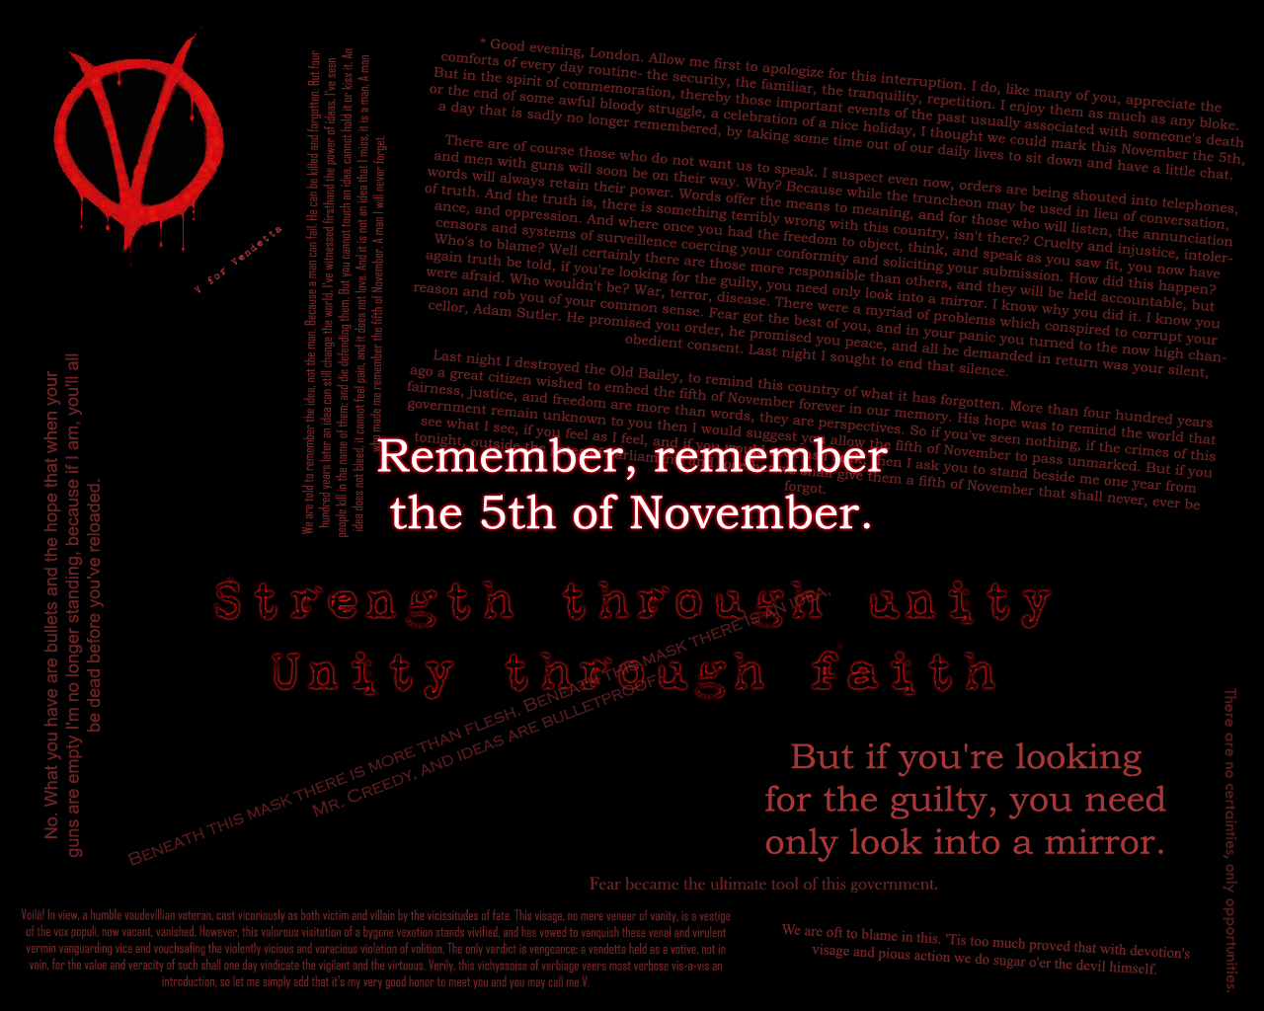
Vendetta’s
Blood feuds often escalated and resulted in endless battles or vendetta’s between the injured factions

Slide 6
Fines: Many societies developed a system of fines to control blood feuds – making them less costly and damaging.
  It became customary for the victim to accept money or property in place of blood
Lex Salica or Wergeld: A fine paid for homicide – the fine varied according to the person’s rank and position in the social group.
  Would become the basis of personal injury lawsuits – Civil Law.

Slide 7
Exile
The first punishment imposed on societies wrongdoers was exile.
Imposing a sentence of exile was the beginning of criminal law as we know it.

Slide 8
Outlaws
Wrongdoers who refused to abide by their sentences (normally payment of fines) were declared to be outside the law of the tribe – an outlaw - Usually exiled.

Slide 9
Early Legal Codes
As societies developed language and writing skills they began to record their laws
An eye for an eye – basis for early codes.
  Sumerian Code (1860 BCE)
  Hammurabic Code (1750 BCE)

Slide 10
Crime and Sin
If the crime offended a divinity than payment to the victim or state was not enough.
Additional punishments were added to appease the Gods or God.
With the growing influence of organized religion the line between state law and church law became increasingly blurred.

Slide 11
The Ordeal
Middle Ages – The “ordeal” was the church’s substitute for a secular trial.
  Trial by ordeal subjected the accused to dangerous and painful tests
  Those who were truly “innocent” would emerge unscathed
  The guilty would suffer agonies and die
  The brutality of most trials ensured a very high percentage of convictions

Slide 12
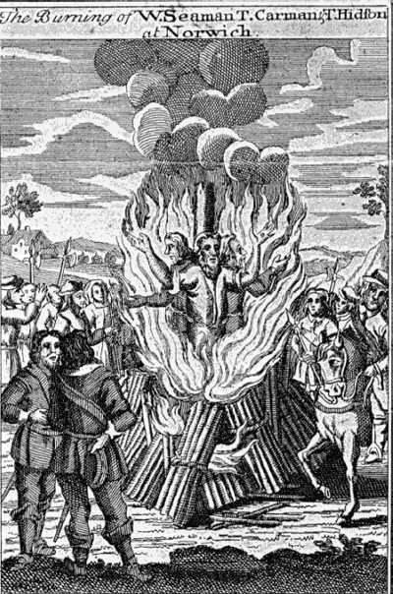

Slide 13
Corporal Punishment
For centuries the most common form of state punishment was death
Other common punishments included: torture, mutilation, branding, public humiliation, fines, forfeits of property and banishment

Slide 14
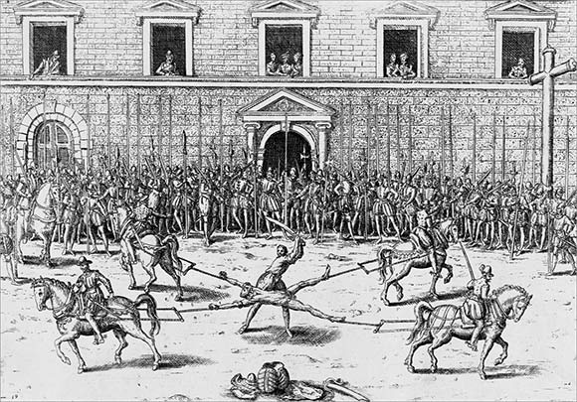

Slide 15
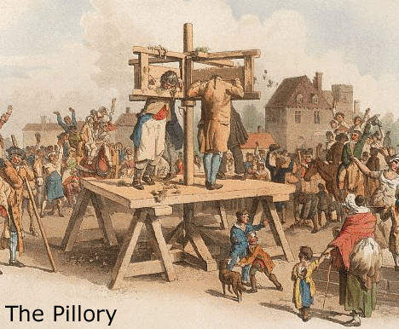

Slide 16
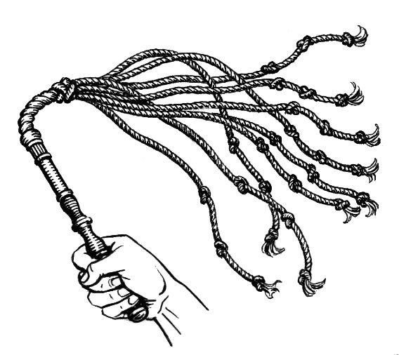

Slide 17
Early Prisons
Prison was not intended as a punishment in and of itself.
Prison was simply a means of holding the accused until a real punishment could be decided and carried out.

Slide 18
Bridewell Workhouse
Created for the employment and housing of London’s “riffraff “in 1557
First time imprisonment and hard labor replace corporal punishment
Housed misdemeanants or petty criminals – “rogues, beggars, idlers and whores”
Deplorable conditions – old, young, male, female, sick, healthy – all mixed together.
Not provided food unless you could pay for it.

Slide 19
Transportation
Throughout Europe the number of imprisonable crimes increased faster than available prison/workhouse space.
Solution = Deportation
Send those concentrated in high-crime slums to the American Colonies
Independence ruins the party, but still need to get rid of misdeamenants
Solution ?

Slide 20
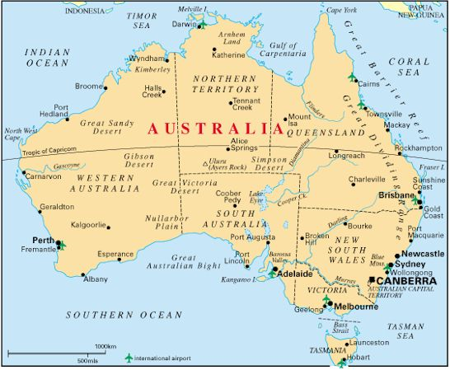

Slide 21
Hulks
1776 – 1875: Deportation options more and more limited
Hulks = Abandoned or unusable transport ships anchored in rivers and harbors and used to confine criminals
“Fetid and rotting human garbage dumps”

Slide 22
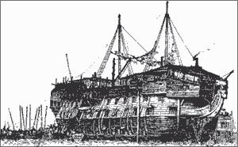

Slide 23
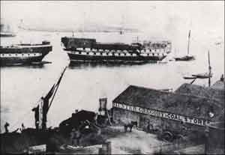
Notes:
Only known photo of prison hulk –
Taken in 1857
Burns shortly after

Slide 24
Cellular Prisons
Start as humanitarian alternative.
Belgium – Maison de Force (stronghouse)
  First system of classification
    Seperated by age, gender, and crime (misdemeannants / felons)
First use of individual cells

Slide 25
BEFORE 1790 THERE WERE NO LONG TERM PENITENTIARIES IN THE WORLD
IN 1790 THE FIRST PENITENTAIRY IS OPENED IN PENNSYLVANIA AND THE MODERN PRISON SYSTEM IS BORN

Slide 26
The Pennsylvania System
Originally called for solitary confinement without work
Architecture = cellular isolation in wings
Offenders would reflect on their crimes all day and repent (Penitentiary)
Effects of extreme isolation led to modifications
  Worked 8-10 hours a day
  Work was done in cell / in isolation
  Received instruction in morals and religion
Emphasis was still on solitary confinement, silence and labor.

Slide 27
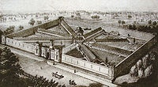

Slide 28
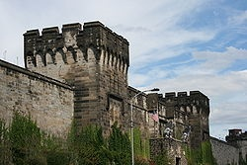

Slide 29
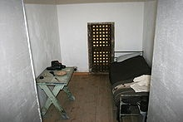

Slide 30
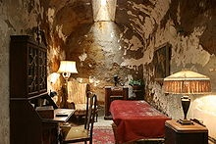

Slide 31
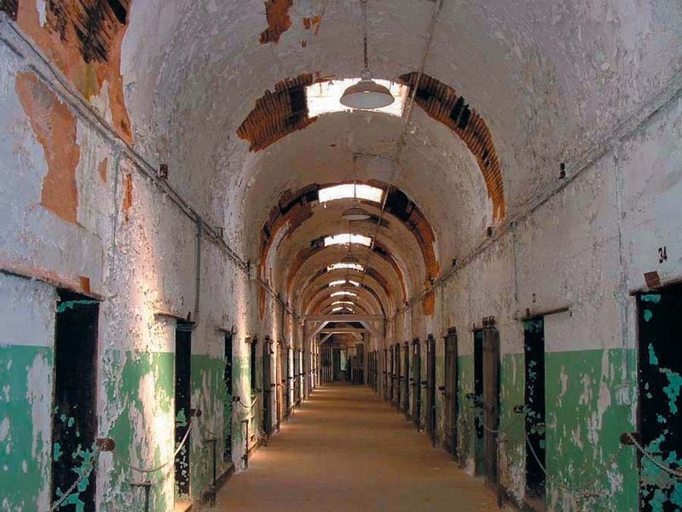

Slide 32
The Auburn System
Cells are much smaller and intended only for sleeping
Work during day in groups
Silence is enforced at all times
  Forbidding speaking takes away prisoners sense of self making them compliant
Solitary confinement is now used as punishment

Slide 33
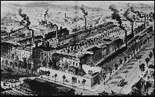

Slide 34
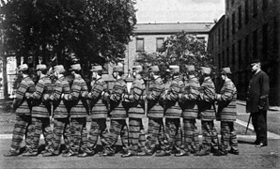

Slide 35
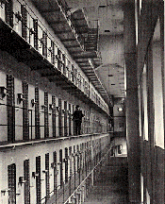

Slide 36
Correctional Ideologies: A body of ideas and practices that pertain to the processing and treatment of offenders.

Slide 37
Punishment Ideology: Offenders should “pay” for their criminal behavior
  Retribution: The government exacts a social “revenge.” Individual chose to break law and deserves punishment.
  Deterrence: punishment that is swift and visible to others will reduce likelihood the individual and others will commit crime.
  Incapacitation: Some can not be rehabilitated so must be isolated and removed from society.

Slide 38
Treatment Ideology:
  Approaches the offender as one who is suffering from a pathology that can be treated.
  Offender must recognize danger of criminal behavior and make efforts to rid themselves of that behavior.
  Goal is to prepare them for reintegration into society.

Slide 39
CONTROL
Rules, Regulations and Policy

Slide 40
Prison Rules and Regulations have one goal
CONTROL
Control is Achieved through
  Depersonlization
  Routinization
  Denial of privacy
Institutional Control is gained by eliminating all prisoner control over their environment.

Slide 41
Control is necessary to:
  Protect prison staff
  Protect inmates
  To rehabilitate inmates
      Instills discipline and values

Slide 42
Prison Rules
Assigned number
Must refer to staff formal titles – Sir/Ma’am
Silence enforced at certain times
Chained or single file marching - Must walk on line
Shaved heads
Uniforms
Limits to personal possessions – both what and how many items one may possess.
Work on chain gangs or other manual labor tasks under strict supervision

Slide 43
Loss of privacy
  Intake: Mass Showers and strip searches
  Toilets open to view
  Showers open or under supervision
  Cells are generally open
  Surveillance

Slide 44
Do what said do,
How said do it,
When said do it.
Eat when told to eat, what your told to eat (quality questionable).
Walk when told to walk
Sleep when told to sleep
Shower when told to shower
Use telephone when told to use telephone

Slide 45
Convict Codes
Show no weakness
Resist control efforts of institution
Loyalty
Respect
Violence may be means to survive

Slide 46
“Convict” Classification System
Inmate: A prisoner who clearly aligns with the institution and its rules.
  Engage in conversation with the staff.
  Cannot take care of own problems so they turn to staff.
  Tend to be rats or snitches
Convict: A prisoner who breaks rules if in his interest and lives with the consequences
  Follows rules only to avoid aggravation and frustration
  Does not engage staff in small talk
  Maintains clear separation between those with the keys and those without

Slide 47
Prisonization
Process by which the inmate learns, through socialization, the rules and regulations of the prison institution.
  Learns both the formal institutional rules and the informal values and customs of the prison (the code).
  Survival often results in becoming inoculated to conventional values
  Values encouraged on the outside can lead to harm
  Values discouraged on the outside are necessary for survival
  Can be seen as a criminalization process where a criminal novice becomes a predatory criminal

Slide 48
Long Term Effects of Prisonization
Prisonization is seen as a “normal” reaction to a set of pathological conditions
Inmates develop habits of thinking and acting that can be dysfunctional in periods of post prison adjustment (temporary)
Consensus – Prisons do not make people go “crazy.”
There are no permanently diagnosed psychiatric disorders related to prisonization

Slide 49
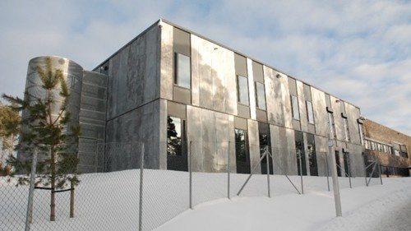

Slide 50
Halden Prison
Running / Hiking Trail
Rock Climbing Wall
Soccer Field
Vocational Education Programs
School Program
Recording Studio
Cooking Classes
Private bathrooms

Slide 51
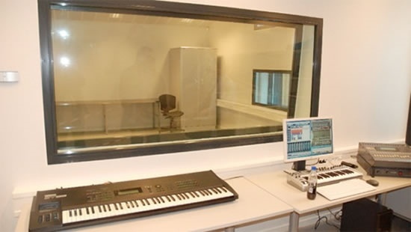

Slide 52
Flat Screen Televisions
Tall vertical windows without bars
Two Bedroom house for conjugal visits
Over half the guards are women – believe that it reduces aggression
Prison has a music teacher
Prisoners are referred to as pupils

Slide 53
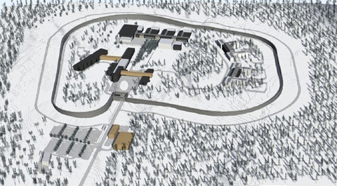

Slide 54
Guiding Principles of Norwegian Prison System
  Focus on Human Rights and Respect
  Repressive prisons do not work
  Treating prisoners humanely boosts their chances of reintegrating into society

Slide 55
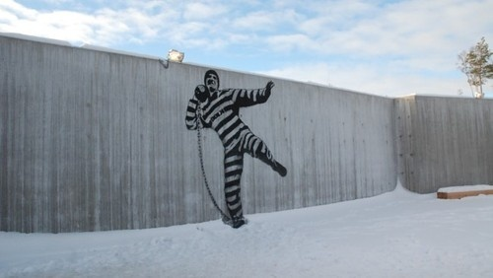

Slide 56
10 years to Build
Cost 252 million
Capacity = 252 Inmates

Slide 57
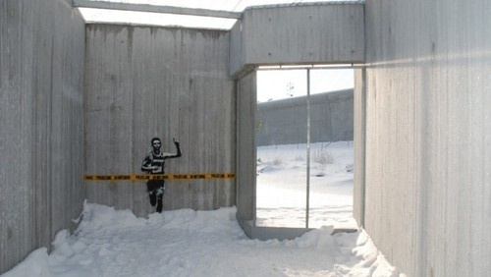

Slide 58
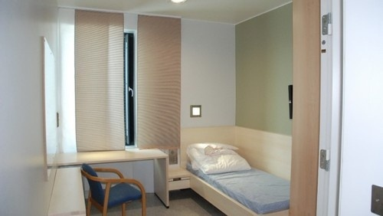

Slide 59
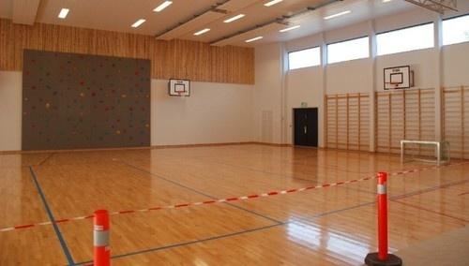

Slide 60
Does it Work?
Recidivism rates in Norway
  20% of Norway’s prisoners end up back in prison
Recidivism rates in United States and United Kingdom
  50-60% of all prisoners return

Slide 61
Norway - Total in Prison = 3300
  69 per 100,000
United States – Total in Prison = 2.3 Million
  753 per 100,000

Slide 62
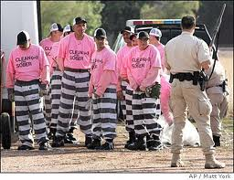

Slide 63
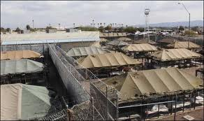

Slide 64
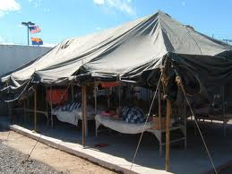

Slide 65
Sheriff Joe v. Norway
Punishment v. Rehabilitation

Slide 66
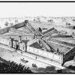

Slide 67
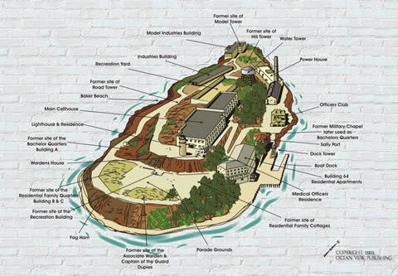

Slide 68
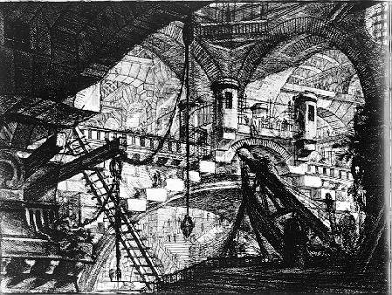

Slide 69
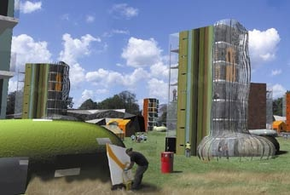

Slide 70
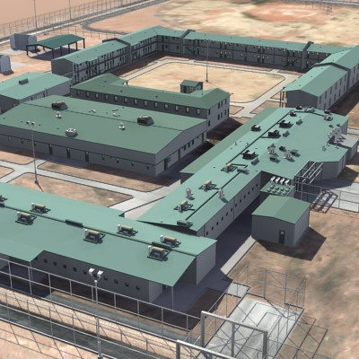

Slide 71
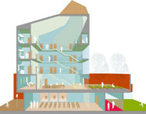

Slide 72
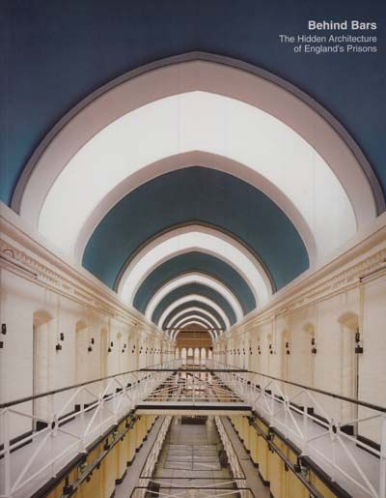

Slide 73
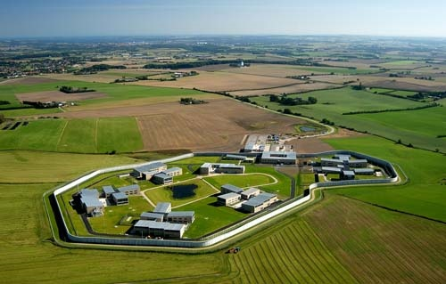

Slide 74
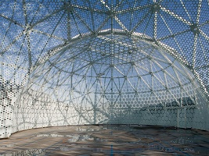

Slide 75
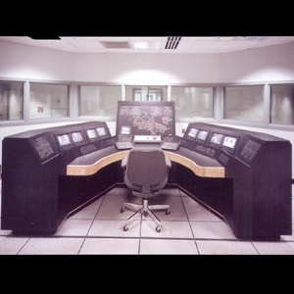

Slide 76
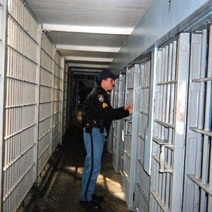

Slide 77
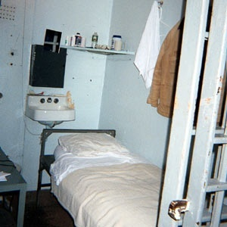

Slide 79
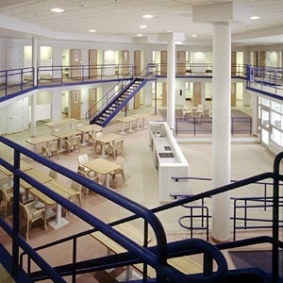

Slide 80
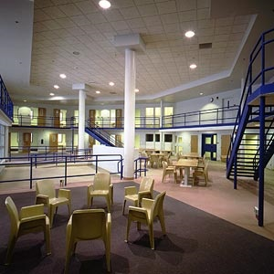

Slide 81
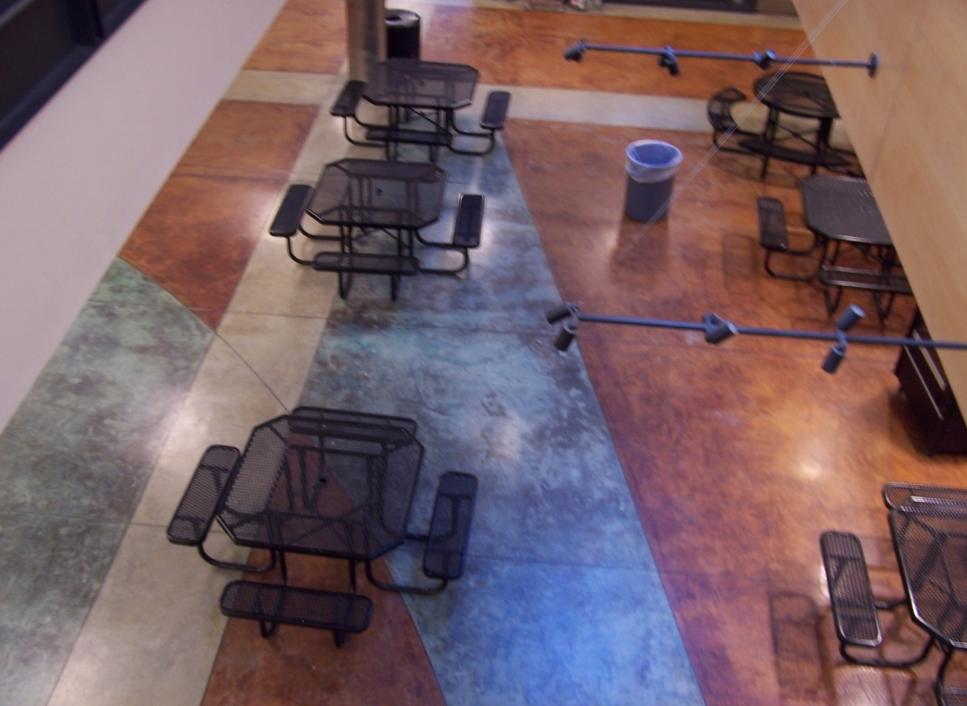
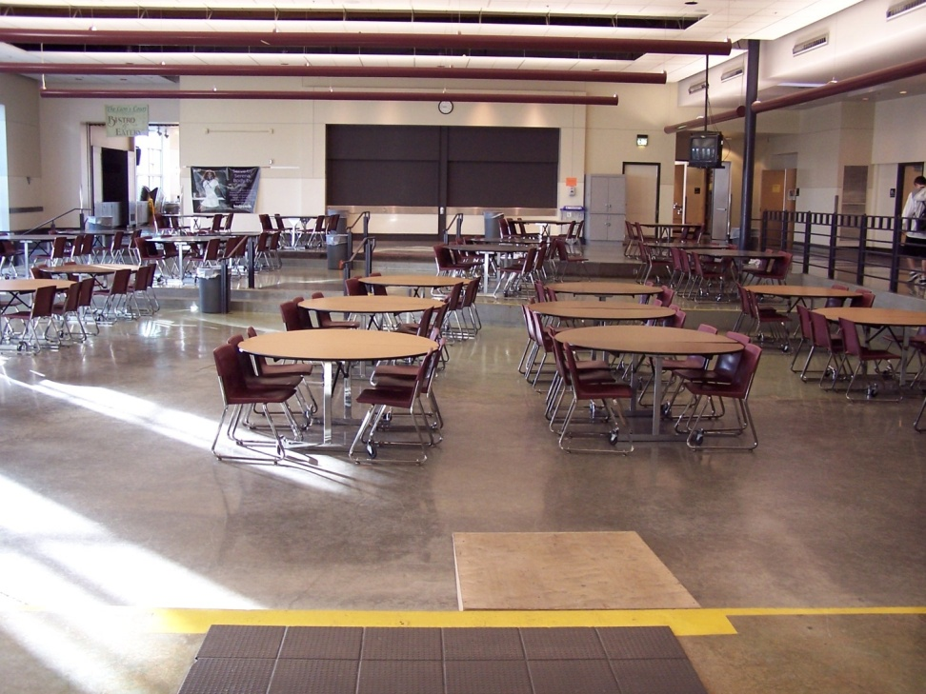

Slide 82
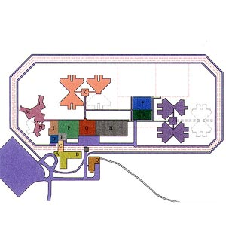

Slide 83
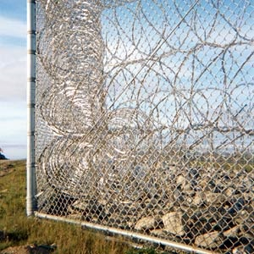

Slide 84
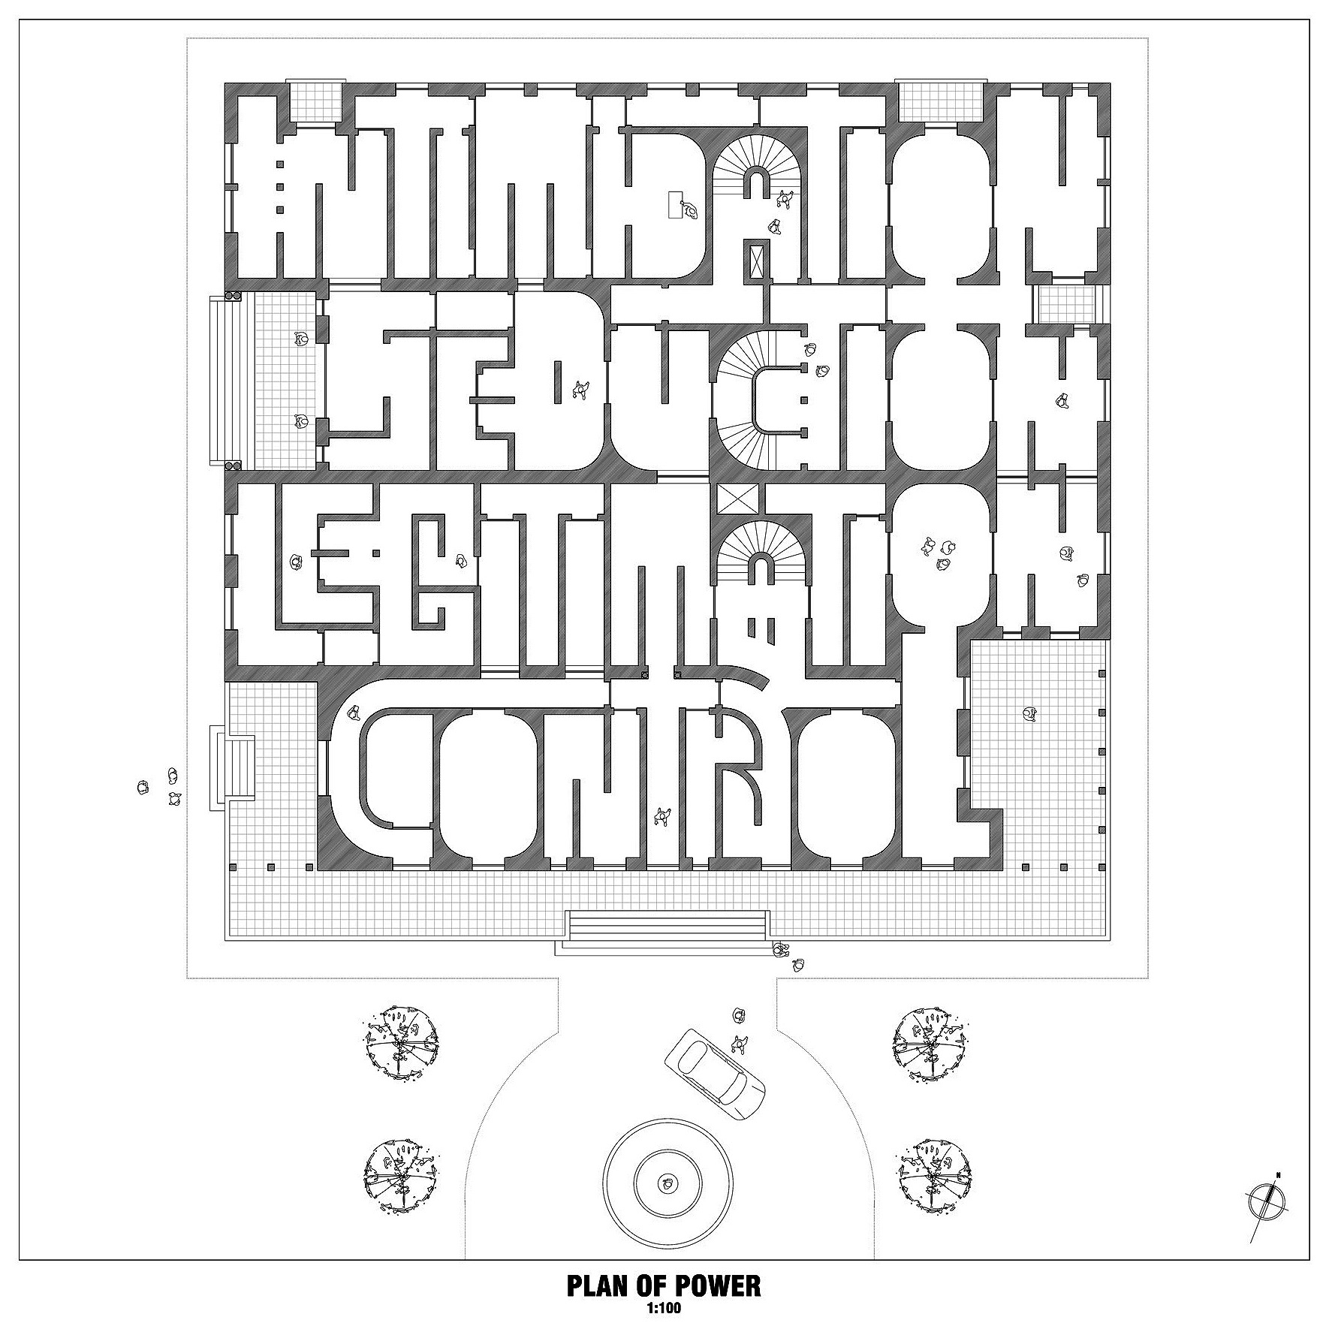

Slide 85
Societal expectation of punishment
Treatment v. punishment
Long term effects
  Is treatment effective
  Is punishment
  Prisons are schools for criminals
  Prison creates a pathological condition in which the normal response is pathological
Need for control v. adverse effects of control
Control for contraband, violence, gangs, sexual assault, etc.
Breaking

Slide 86
  List and explain 3 guiding principles and goals.
  Create a physical environment and explain how it will work towards achieving your goals.
  Create a daily regiment (what will prisoners day consist of) and explain how the regimen will achieve your goals.
  Must be “constitutional” – 8th amendment forbids torture etc.

Slide 87
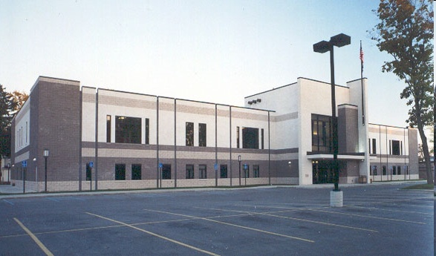
Jail v. Prison
What is the Difference?

Slide 88
Jail: Generally a county or city run facility.
Prison: State or Federal run facility.

Slide 89
Jail: Houses pretrial defendants unable to make bail, misdemeanor offenders, relatively short-term felony offenders and short and long term felony offenders awaiting transfer to a state prison
Prison: Long term felony offenders

Slide 90
Jail: Length of sentences tend to be 1 year or less
Prison: Length of sentences tend to be longer than 1 year

Slide 91
Jail: Tends to be small. Over 2/3 have an average daily population of fewer than 100 inmates.
Prison: Over half have an average daily population larger than 400 inmates.

Slide 92
Jail: Take and release inmates. Nearly 85% of those admitted to jail will be released within 4-5 days.
Prison: Take and hold inmates.

Slide 93
Jail: Highest official is typically the sheriff – an elected official. Background tends to be law enforcement not corrections.
  Route to winning election usually has get tough on crime emphasis.
Prison: Officials tend to be career corrections professionals.

Slide 94
Jail: Funding from County commissions – which have limited ways to raise revenue.
Prison: Funding from State and Federal legislatures – more ways to raise revenue and large resource base.

Slide 95
Because inmates move through jail so quickly it creates a more chaotic setting:
  Fewer resources ($) – staff, facilities, training, programs etc.
  Overseen by law enforcement not corrections professionals.
  Classification tends to be more haphazard (mixing of high risk / low risk prisoners).
  Routine is less structured. More time is idle.
  Jail inmates tend to enter in crisis.
  More likely to be vulnerable
    Mental illness
    Inexperienced with incarceration
    Drunk or high
    Suicidal

Slide 96
End result – Jails tend to be more dangerous places.
  Inmates who spend time in both facilities report that their time is much harder and dangerous in jail.

Slide 97
Prison Security Levels

Slide 98
Maximum Security
Designed and built to minimize escape, disturbance, and violence while maximizing control over the prison population.
Walls/fencing (30-50 feet high), razor wire, towers with armed guards.

Slide 99
Medium Security:
Designed, built and operated to prevent escape, disturbance and violence.
Fewer restrictions on movement and activities than max.
Somewhat less regimented.
Cells often more “room” like – dorms.
Fewer prisoners

Slide 100
Minimum Security
Allows maximum inmate movement, freedom and self-determination.
Methods of control are less obtrusive.

Slide 101
State Prisons in Oregon
  Maximum
    Oregon State Penitentiary
  Medium
    Coffee Creek Correctional Facility
    Deer Ridge Correctional Institution
    Snake River Correctional Facility
    Two Rivers Correctional Facility
    Eastern Oregon Correctional Facility
    Oregon State Correctional Institution (closed)
  Minimum
    Powder River Correctional Facility
    Shutter Creek Correctional Institution
    South Fork Forest Camp
    Warner Creek Correctional Facility
    Mill Creek Correctional Facility
    Santiam Correctional Institution
    Columbia River Correctional Institution
  Future Sites
    Junction City
    White City

Slide 102
Federal Prisons in Oregon
  Sheridan: Medium Security

Slide 103
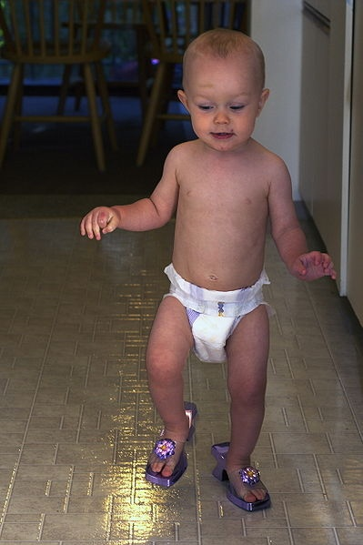

Slide 104
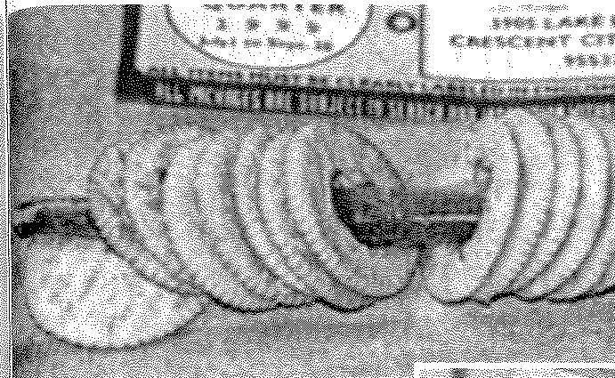
MARIJUANA INSIDE RITZ CRACKERS.

Slide 105
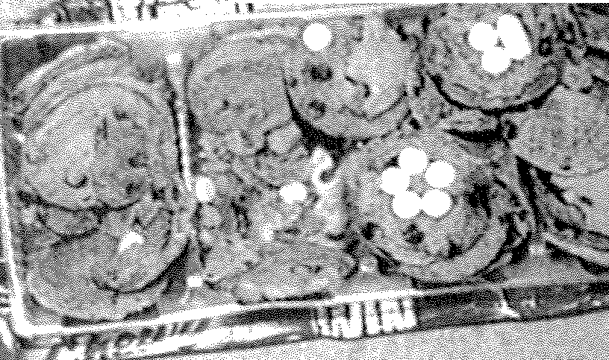
PHARMACEUTICAL DRUGS IN THE SHAPE OF PILLS PRESSED INSIDE CHIPS AHOY COOKIES.

Slide 106
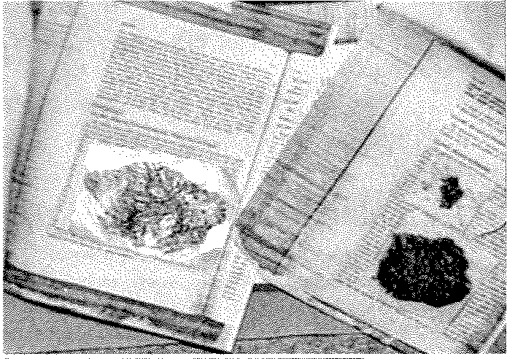
Tar Heroin sealed between pages of a legal document.

Slide 107


Slide 108


Slide 109
"HEROIN CAME SEALED INSIDE CEREAL BOXES AND PACKS OF CARAMEL CORN.
COCAINE WAS STASHED INSIDE OREO COOKIES AND BARS OF SOAP.
CHILDREN'S DRAWINGS AND GREETING CARDS WERE SOAKED IN METHAMPHETAMINE.
TAR HEROIN WAS SEALED INSIDE TWO POSTCARDS STUCK TOGETHER TO LOOK LIKE ONE."

Slide 110
New Threat on the “Cell” Block
Cell Phones
  Inmates could organize simultaneous riots in multiple correctional facilities
  Hatch an escape plot via text messages or the internet
  Control criminal organizations from within prison

Slide 111
Cell phones potentially more lucrative than drugs.
Inmates rent the phone to other prisoners for up to $20 for 5 minutes.
A perk of this business for the inmates is that it's not a felony, so if they get busted (again), there will likely be no additional jail time.

Slide 112


Slide 113


Slide 114


Slide 115


Slide 116


Slide 117


Slide 118


Slide 119


Slide 120


Slide 121
How does all this stuff get smuggled into a secure facility?
Guards blame visitors
Inmates say most comes in through guards

Slide 123

SuperMax

Slide 124

Super Maximum Prison (SuperMax):
  Provides for management and control of inmates designated as violent or seriously disruptive.
  Only separation, restricted movement and limited direct access to staff and inmates can control their behavior.

Slide 125

Restrictions and conditions common to Supermax:
  Single-cell confinement for up to 23 hours per day.
  Substantially higher staff-to-prisoner ratios than most other prisons.
  Offer few, if any, programs to prisoners.
  Restrain prisoners with handcuffs during any out-of-cell movement.
  Permit few, and only non-contact, visits.
  Typically are more technologically advanced than other prisons.

Slide 126

Twenty years ago there was one supermax facility in the United States (Marion, Illinois).
Today there are 57 supermax facilities that house over 20,000 inmates.
Over 40 states now have a supermax prison.

Slide 127
Special Housing Unit (SHU): Prison within a prison. Basically Supermax units within a maximum security facility. Separates most dangerous inmates and puts them in solitary units.
  Federal system refers to supermax prisons as SHU’s.

Slide 128

80,000 inmates currently in solitary confinement – combination of Supermax and/or SHU.

Slide 129

Security Threat Groups (STGs) :
  Prison gangs.
  Official Definition: two or more inmates, acting together, who pose a threat to security or safety of staff/inmates and are disruptive to the orderly management of the facility.
  Plan, organize and commit unlawful acts such as contract murders, homosexual prostitution, drug trafficking and gambling.

Slide 130
Congressional Hearing
SOLITARY CONFINEMENT
Issue: Should the federal government continue the use of solitary confinement in the federal prison system
    Is the use of solitary confinement a violation of the 8th amendment?
    Is it effective? Does it actually achieve its goals or have unintended negative results.
  Three Groups - Congress – Prepared to grill both sides
    ACLU – Against solitary
    DOC – Supporting solitary
  One Sheet Movie Notes – Probably all bad for supporters, but you will know your opponents arguments
  Each person should develop 2 arguments with supporting details and evidence – come prepared with a one page cheat sheet to argue.

Slide 131
Eighth Amendment
Excessive bail shall not be required, nor excessive fines imposed, nor cruel and unusual punishments inflicted.

Slide 132
QUESTIONS PRESENTED
1. Does imposition of a life-without-parole sentence
on a 14-year-old child convicted of homicide violate
the Eighth and Fourteenth Amendments’
prohibition against cruel and unusual punishments?
2. Does such a sentence violate the Eighth and
Fourteenth Amendments when it is imposed
upon this 14-year-old petitioner, who did not personally
kill the homicide victim, did not personally
engage in any act of physical violence toward
the victim, and was not shown even to have anticipated,
let alone intended, that anyone be
killed?
3. Does such a sentence violate the Eighth and
Fourteenth Amendments when it is imposed upon
a 14-year-old child as a result of a mandatory
sentencing scheme that categorically precludes
consideration of the offender’s young age or any
other mitigating circumstances?

Slide 133
Jackson v Hobbs & Miller v. Alabama (2012):
Court is considering whether life without parole for juveniles who commit murder is unconstitutional.

Slide 134
Supreme Court Decisions
Wilkerson v. Utah (1878): Court upholds execution by firing squad but prohibits drawing and quartering, burning alive and disemboweling – none were common.

Slide 135
Weems v. United States (1910): For the first time, the court overturns a sentence it considers unconstitutional – hard labor and being shackled throughout one’s incarceration.

Slide 136
Furman v. Georgia (1972): The court imposes a moratorium on the death penalty, saying it was being applied in an arbitrary and inconsistent manner. Four years later, the ban was lifted.

Slide 137
Atkins v. Virginia (2002): The court bars the execution of the mentally handicapped.

Slide 138
Roper v. Simmons (2005): The death penalty is ruled unconstitutional for those who were under age 18 at the time the crime was committed.

Slide 139
Baze v. Rees (2008): The court rules that execution by lethal injection does not violate the eighth amendment.

Slide 140
Kennedy v. Louisiana (2008): The court restricts the death penalty to crimes in which the victim is killed, or cases of treason.

Slide 141
Graham v. Florida (2010): The court rules that life without parole for juveniles in cases that do not involve killings is unconstitutional.

Slide 142
Life Without Parole
States With The Most Juvenile Offenders Serving Life Without Parole
Pennsylvania | 444
Michigan | 346
Louisiana | 335
Florida | 266
California | 250
Missouri | 116
Illinois | 103
Arkansas | 73

Slide 143
Special Management Meal
    6 slices whole wheat bread, finely chopped
    4 ounces imitation cheddar cheese, finely grated
    4 ounces raw carrots, finely grated
    12 ounces spinach, canned, drained
    2 cups dried Great Northern Beans, soaked,
    cooked and drained
    4 tablespoons vegetable oil
    6 ounces potato flakes, dehydrated
    6 ounces tomato paste
    8 ounces powdered skim milk
    4 ounces raisins

